Slide 1
Characteristics of Zener Diode

Slide 2
Ordinary diodes are forward biased and work in the forward direction.
They have a large forward current flowing through them with a negligible voltage drop across them.
If we operate an ordinary diode in reverse biased, it conducts insignificant current until the voltage applied across them exceeds the reverse breakdown voltage.
Once that happens, large current flows through the junction and the diode may get destroyed.
The Zener diode is a particular type of diode that solves this problem.
We operate a Zener diode in reverse biased conditions, and this diode does not get damaged even when the voltage across this exceeds the reverse breakdown voltage.

Slide 3
Let us learn about this exciting and unique kind of diode.
Zener diodes are heavily doped than ordinary diodes.
They have extra thin depletion region.
When we apply a voltage more than the Zener breakdown voltage (can range from 1.2 volts to 200 volts), the depletion region vanishes, and large current starts to flow through the junction.
There is a crucial difference between an ordinary diode and a Zener diode.
The depletion region regains its original position after removal of the reverse voltage in Zener diode
whereas in regular diodes, they don’t, and hence they get destroyed.

Slide 4
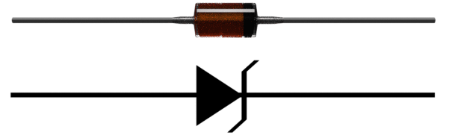
Here is the Zener diode symbol

Slide 5
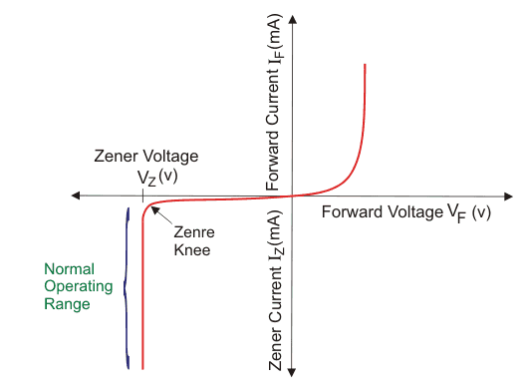
Let us now look at the Zener diode characteristic:
A graph of current vs the voltage across the device is called the characteristic of Zener diode.
The first quadrant is the forward biased region. Here the Zener diode acts like an ordinary diode.
When a forward voltage is applied, current flows through it. But due to higher doping concentration, higher current flows through the Zener diode.

Slide 6
In the third quadrant, The graph shows the current vs voltage curve when we apply a reverse bias to the diode.
The Zener breakdown voltage is the reverse bias voltage after which a significant amount of current starts flowing through the Zener diode.
Here in the diagram, V_{Z} refers to the Zener breakdown voltage.
Until the voltage reaches Zener breakdown level, tiny amount of current flows through the diode.
Once the reverse bias voltage becomes more than the Zener breakdown voltage, a significant amount of current starts flowing through the diode due to Zener breakdown.

Slide 7
The voltage remains at the Zener breakdown voltage value, but the current through the diode increases when the input voltage gets increased.
Due to the unique property of Zener diode, the depletion region regains its original position when the reverse voltage gets removed.
The Zener diode doesn’t get damaged despite this massive amount of current flowing through it. This unique functionality makes it very useful for many applications.
As the voltage remains at the Zener breakdown voltage, we use Zener diodes for voltage regulation.
We use them in voltage stabilisers and various other protection circuits.
We also use them in clipping circuit and clamping circuit.
They provide a low-cost solution for voltage regulation.

